Slide 1
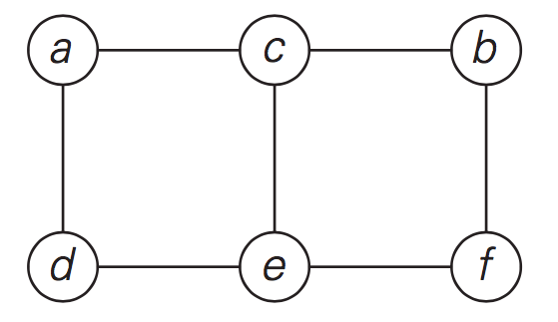
Adjacency Matrix and Adjacency List

Slide 2
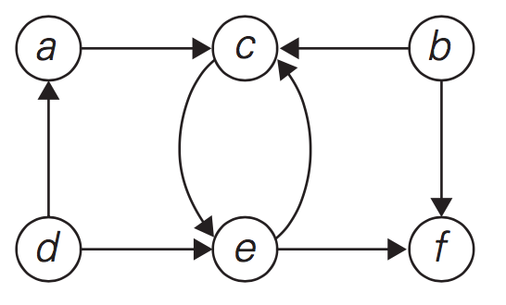
3
5
10
4
20
7
9
1
Adjacency Matrix and Adjacency List

Slide 3
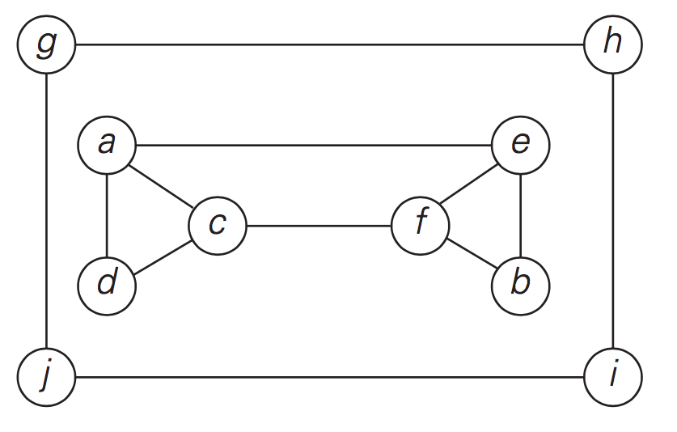
DFS, BFS

Slide 4
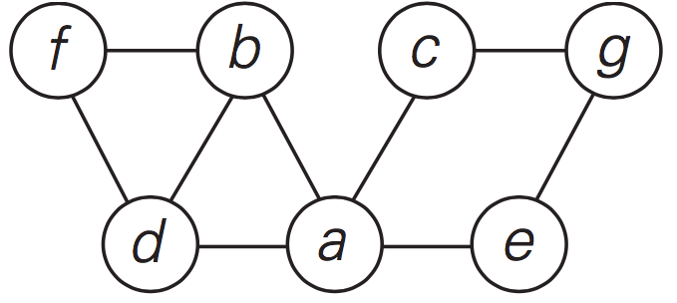
h
j
i
Practice: DFS, BFS

Slide 5
How to find all articulation points in a given graph?

Slide 6
How to find all articulation points in a given graph?
u is not root of DFS tree and it has a child v such that no vertex in subtree rooted with v has a back edge to one of the ancestors (in DFS tree) of u.

Slide 7
Topological Sorting
Topological sorting for Directed Acyclic Graph (DAG) is a linear ordering of vertices such that for every directed edge uv, vertex u comes before v in the ordering. Topological Sorting for a graph is not possible if the graph is not a DAG.

Slide 8
Topological Sorting
We can modify DFS to find Topological Sorting of a graph. In DFS, we start from a vertex, we first print it and then recursively call DFS for its adjacent vertices. In topological sorting, we use a temporary stack. We don’t print the vertex immediately, we first recursively call topological sorting for all its adjacent vertices, then push it to a stack. Finally, print contents of stack.
0
5

Slide 9
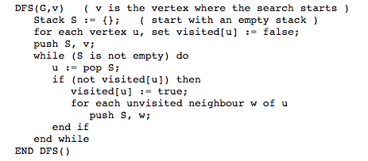
Implement DFS using a stack

